Slide 1
Latest knowledge on the epidemiology of African swine fever in Hungary
University of Veterinary Medicine
Budapest
17.09.2024.
Zsolt Földi DVM
Head of National CSF and ASF Expert Group
Notes:
I am glad to be here and to talk to you about this topic.

Slide 2
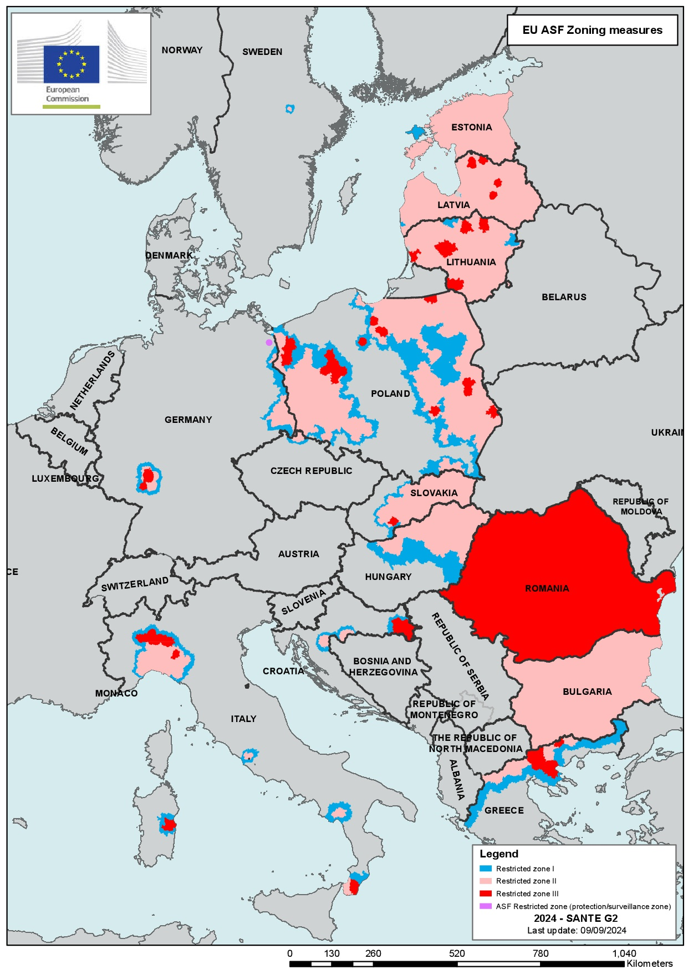
Restricted areas in the EU due to ASF
Notes:
Red= ASF occours WB & domestic pigs, pink = ASF occours only in WB, blue = high risk are between the infected and the free area

Slide 3
The start of professional work based on risk analysis
The CVO established the ASF Risk Analysis Working Group in September 2017 on the recommendation of the National CSF and ASF Expert Group.
At that time, Hungary was free of the disease, but ASF was present in the Transcarpathian region of neighbouring Ukraine.
Since the working group had a relatively large number of experts, they established the principles and the ASF Risk Analysis Action Group was created within the working group in order to work efficiently.

Slide 4
The Hungarian ASF risk assessment system is established 1.
In early February 2018, the Action Group formulated a detailed proposal on
- identifying the risk of the introduction of ASF to the country and
- the determination of areas of the country with high, medium and low ASF risk.

Slide 5
The Hungarian ASF risk assessment system is established 2.
During this work several aspects were taken into consideration, the most important ones were the followings:
• The estimated wild boar population and density of wild boars
• The hunting (game) management units (its border and territory)
• Number and distance of reported ASF wild boar cases in neighbouring countries
• Possibility and speed of spread of the disease in wild boars
• Possibility of spread by other means (human factor, etc.)
• Natural and artificial borders (barriers)
Notes:
However I don't want to highlight any of these issues now, because we will talk about the most important ones later

Slide 6
ASF risk analysis system, main conclusions 1.
The wild boar population play an important role in the risk analysis of the introduction of the disease, since the disease was officially present in wild boar in Transcarpathia (Ukrainian region neighbouring Hungary).
According to data from the European Food Safety Authority (EFSA) the disease spreads further slowly (1-2 km in a month), but continuously in wild boars, even without human interaction,
The Action Group assumed that in those hunting management units where the wild boar population density is higher, the sharing of food resources is more necessary and the number of animal-to-animal contacts is higher.

Slide 7
ASF risk analysis system, main conclusions 2.
The risk posed by ASF also depends on the distance to the confirmed cases in wild boars.
The most realistic picture of the level of risk of ASF in some areas of the country can be obtained by excluding major jumps that may occur due to random events (mainly human factors), which cannot be reliably predicted in advance
To determine the distance from the wild boar cases to be considered in a risk analysis, the analysis of the cases in the Czech Republic confirmed in 2017 provided a good basis, as they were close in geographically and in time to each other and likely the wildlife characteristics did not differ significantly from the Hungarian wild boar population.

Slide 8
ASF risk analysis system, main conclusions 3.
The Czech cases was found at a large distance from other cases or outbreaks, and it can be assumed that it originated from a single source.
When analysing the distance between all cases detected between 21.06.2017 and 26.09.2017 in the Zlínský region of the Czech Republic, the maximum distance between two cases was 16 km. Rounding this upwards, we calculated and calculate a distance of 20 km by default.
The most appropriate method for defining high and medium risk areas, and from April 2018 also for defining extremely high risk (infected) areas, is a risk analysis based on data on the density of wild boars per hunting unit and distances from confirmed wild boar cases.

Slide 9
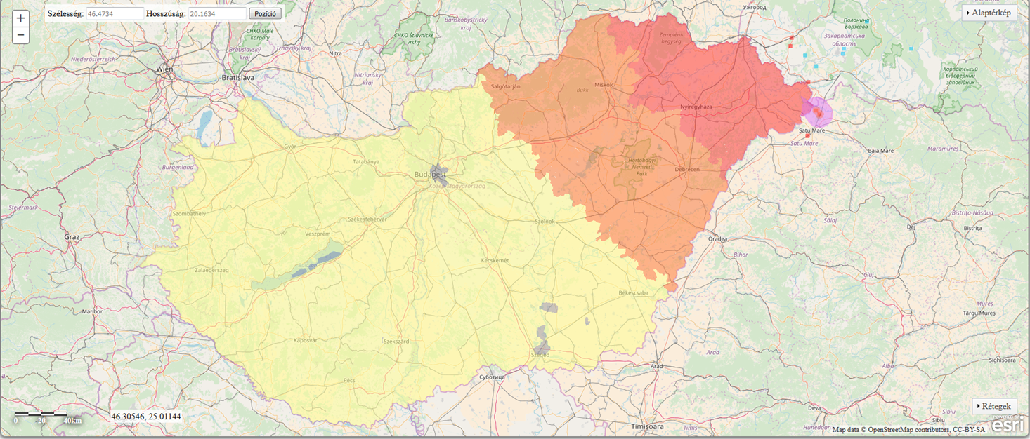
ASF risk areas in February 2018

Slide 10
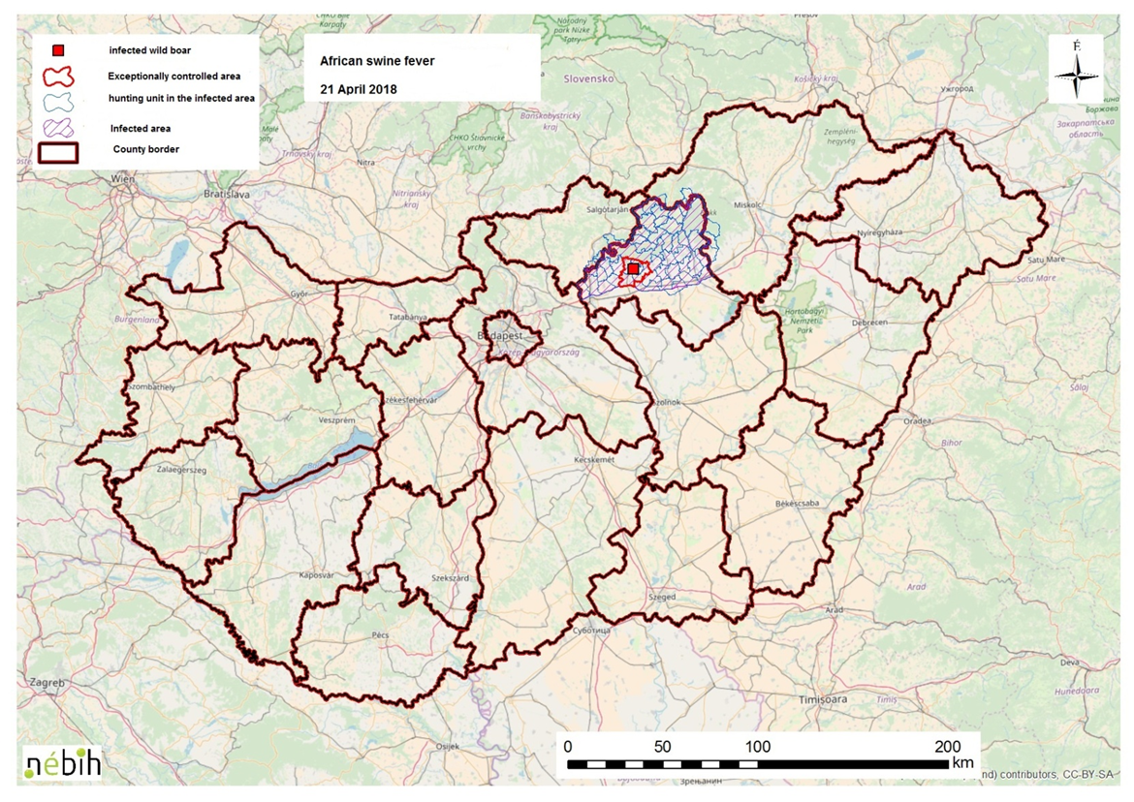
The first ASF case in Hungary – 21.04.2018.

Slide 11
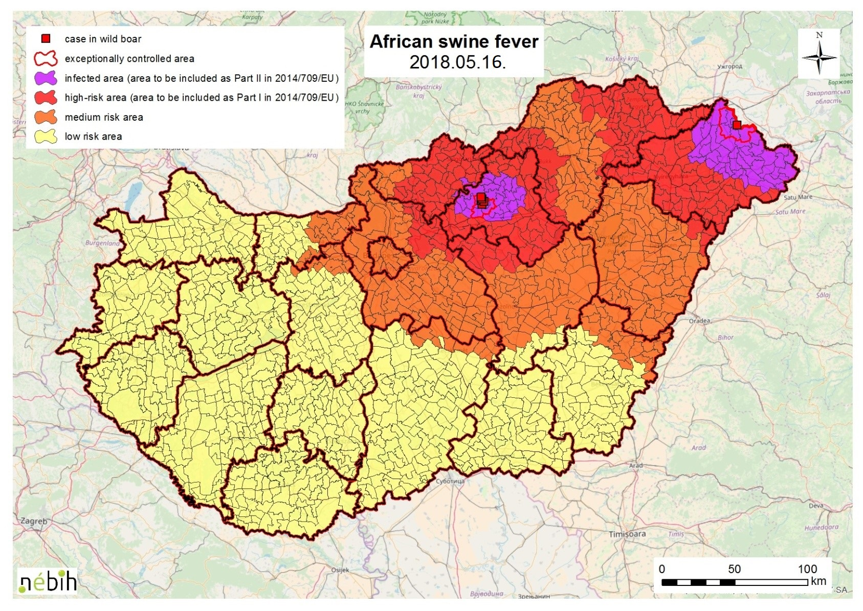
Official ASF risk areas after the infection of Szabolcs-Szatmár-Bereg County (May 16, 2018)

Slide 12
ASF risk analysis – practical implementation 1.
First level
• We use an own algorithm running in an R software environment to identify extremely high risk (infected), high risk and medium risk hunting (game) management units (the low risk area classification was discontinued following the proposal of the National Expert Group meeting in December 2019).
• The algorithm defines these areas based on the density of wild boars in the hunting management units and the distance of the hunting management units from the wild boar cases in Hungary, and from wild boar cases near the Hungarian border (within an about 20 km wide belt).
• For interactive visualisation we use QGIS software

Slide 13
ASF risk analysis – practical implementation 2.
Second level
The Expert Group will make the final decision taking into account other important factors such as effective natural and artificial barriers, epidemiological information, in particular the geographical location of new cases in relation to previous cases, the distance of new cases from the boundary of the infected and high risk area
Update
We updated the risk analysis for any significant change in the epidemiological situation
Modification of the system
If justified by practical experience

Slide 14
ASF risk analysis – practical implementation 3.
The most important modifications of the risk analysis system
In 19 July 2021 it has been proposed that administrative decisions should then be based on a risk analysis taking into account cases within one year (last year). It was preceded by a comprehensive retrospective study. It was necessary because we had taken into account all the cases that had occurred until then, so the risk would never have decreased or disappeared.
In 17 August 2022 the existing risk analysis has been supplemented with a second step, in the case of hunting management units that could be reclassified from extremely high risk to high risk based on the first (original) step.

Slide 15
Adding a new second step to the ASF risk analysis 1.
In the 2022/2023 hunting year, there was a few occasions within the infected area where the distance between a new case and the nearest case within one year was much greater than usual (large jumps of at least 20 km).
This could be a problem if the ASF risk of hunting (game) management units close to such a new case had decreased prior to the big jump, and therefore during the first step a proposal was made to reclassify these units from infected to high risk.

Slide 16
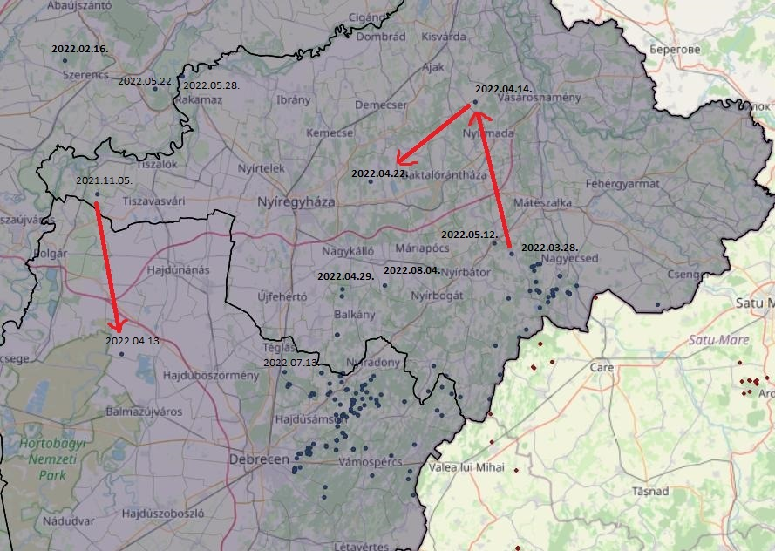
Map - Cases with a big jump

Slide 17
Adding a new second step to the ASF risk analysis 2.
After a comprehensive analysis, the Risk Analysis Action Group decided to add a second step to the current risk analysis system, where the algorithm examines whether cases within one year have occurred within 30 km radius of the border of the units proposed to be reclassified (in the first step of analysis) from the infected area (from extremely high risk) to high risk. If yes, the infected (extremely high risk) area remains the classification of these units.
This procedure provides more reliability than before for possible area reductions, while at the same time providing an appropriate level of risk reduction for this risk analysis.

Slide 18
The effectiveness of ASF risk analysis so far
The effectiveness of the risk assessment is well characterized by the fact that 99.9 percent of all ASF cases confirmed in wild boars in Hungary until September 5. 2024 were found within the infected area.
Moreover, from January 1, 2021, all confirmed wilde boar cases occurred within the infected area.
So we have improved this already extremely effective system even further by introducing the second step mentionded earlier.

Slide 19
Proposal of the National Expert Group on 15 September 2022 and changes to the official risk areas from 27 June 2023
At its meeting on 15 September 2022, the National Expert Group, after analysing the risk analysis, the epidemiological situation and the negative PCR results, recommended the followings:
Reduction of the infected area in Jász-Nagykun-Szolnok (+ 1 hunting (game) management unit in Pest county adjacent to JNK county) and Békés counties
Reduction of the high risk area in the counties of Bács-Kiskun, Békés, Csongrád-Csanád and Jász-Nagykun-Szolnok
The proposal was finally adopted in Brussels in June 2023 and it entered into force on 27 June 2023

Slide 20
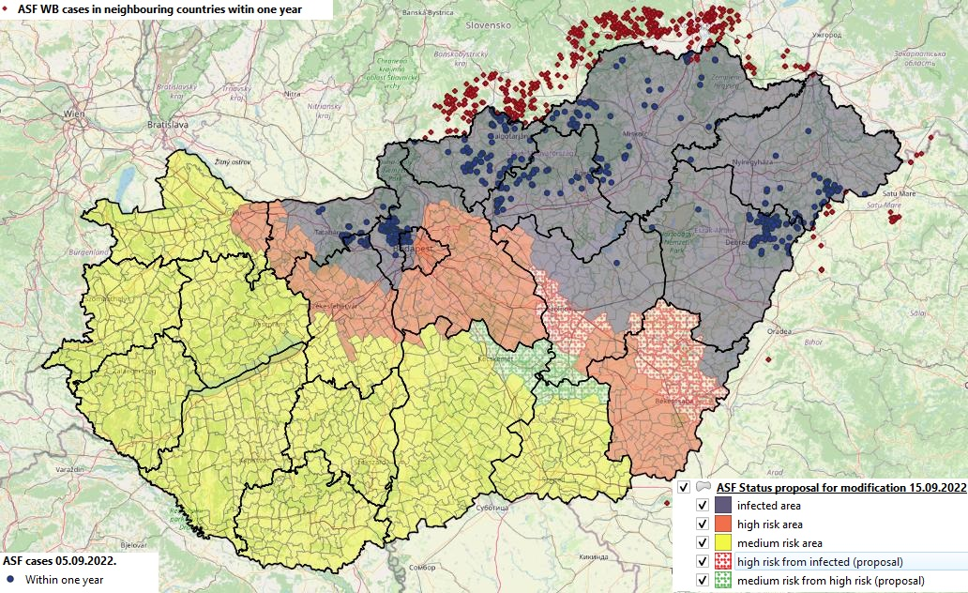
Proposal of the National Expert Group on 15 September 2022 - national overview map

Slide 21
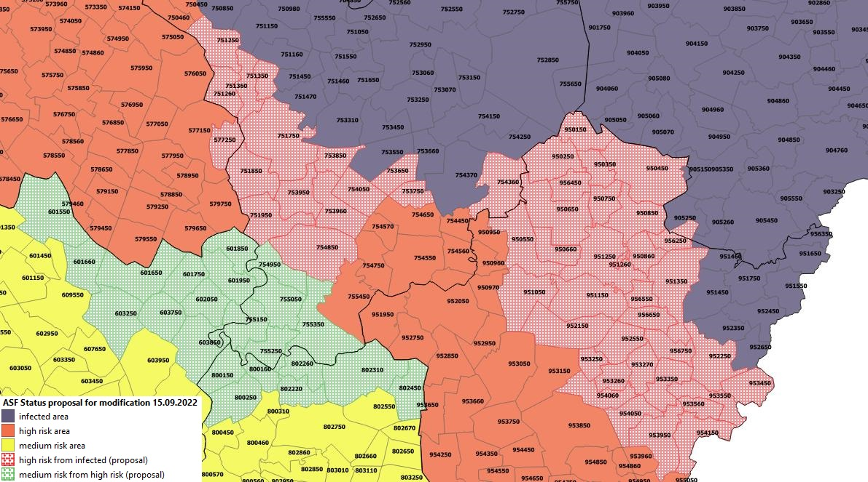
Proposal of the National Expert Group on 15 September 2022 – closer map

Slide 22
New proposals from the National Expert Group between June 2023 and March 2024, to further reduce official risk areas
At its meetings held between June 2023 and March 2024, the National Expert Group, after analysing the risk analysis, the epidemiological situation and the negative PCR results, recommended
Reduction of the infected area in Jász-Nagykun-Szolnok and Békés counties
Reduction of the high risk area in the counties of Békés, Jász-Nagykun-Szolnok and Pest
An formal document based on these proposals is currently being examined by the EU Commission. At the Commission's request, the original proposal had to be amended yesterday in the case of Békés county.

Slide 23
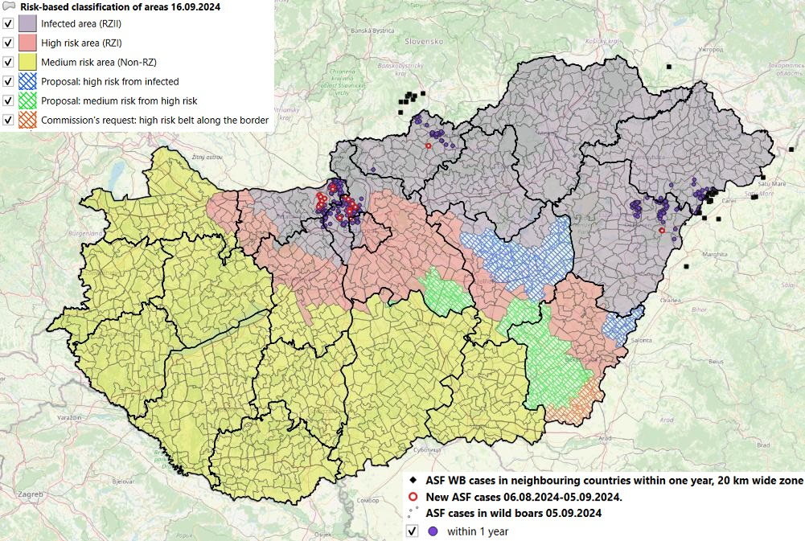
New proposals from the National Expert Group 2023-2024. – national overview map

Slide 24
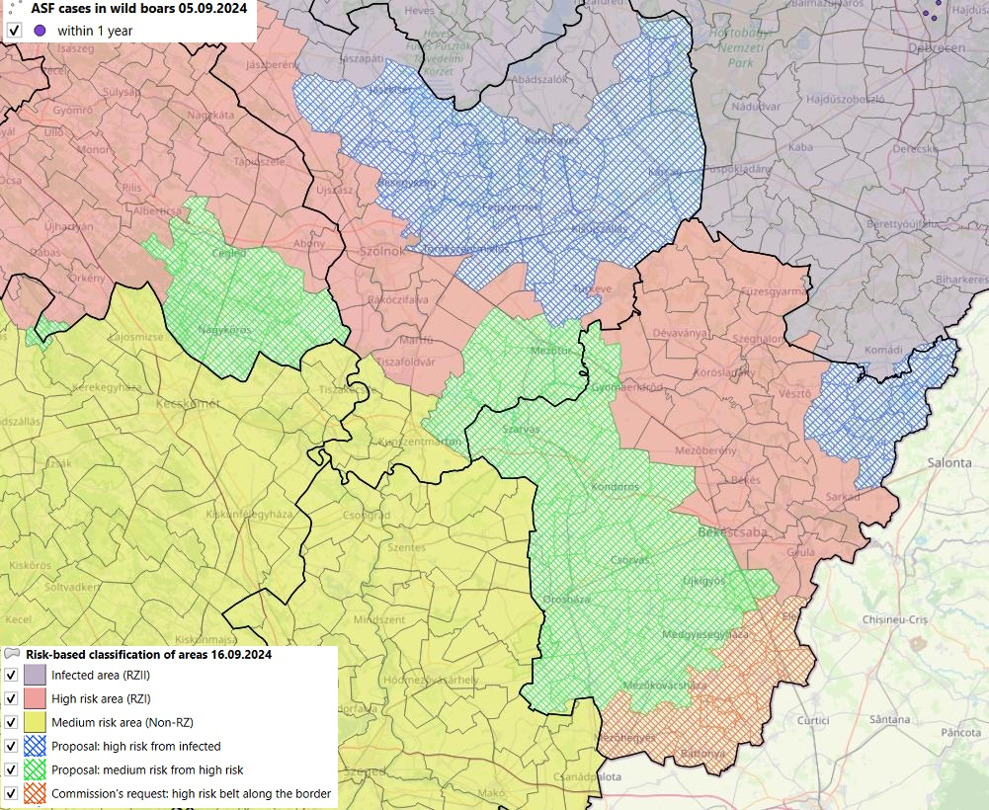
New proposals from the National Expert Group 2023-2024. – close map

Slide 25
Surveillance system in general
The surveillance system is designed to detect diseases, preferably early, or to prove that a disease is not present. There are two types:
passive (general) surveillance, and
active (targeted) surveillance
The classical form of passive surveillance involves only investigations of suspected cases confirmed by the authority, but it is less reliable
We can also talk about a so-called enhanced passive surveillance system, where we also examine animals where the suspicion has been ruled out by the authorities, but there are clinical signs or pathological lesions associated with the disease, or they have simply died without the suspicion being raised
Active surveillance always involves the examination of clinically healthy animals or animals without suspicious pathological lesions according to a pre-established pattern

Slide 26
Surveillance system for ASF
In the case of ASF, enhanced passive surveillance is the first priority, as ASF is not really a highly contagious disease. Only around 10 % of the population becomes infected and sick within 2 weeks of the first introduction, but almost all sick animals die.
Because of the above, active surveillance is less certain, and in most cases late in detecting the presence of the virus
However active surveillance is also necessary in wild boars, especially in infected and high risk areas, although it is of less importance for early detection in itself, but it increases the reliability of the surveillance system in view of the difficulties in finding dead wild boars. In high risk areas, it allows the use of carcasses of shot wild boars in case of negative PCR result (!).

Slide 27
ASF surveillance system for wild boars
In addition to officially confirmed suspicion, enhanced passive surveillance requires virology (PCR) testing of
all dead wild boars, including those died due to a traffic accident
all wild boars shot due to clinical signs
Annex IV to the ASF Contingency Plan contains detailed guidance on the official confirmation of suspicion of ASF/ CSF
Active surveillance means virological (PCR) testing for ASF in wild boars that appear clinically healthy and are shot during culling or hunting.
The ASF Eradication Plan has separate chapters on passive and active surveillance per risk category

Slide 28
Counties infected with ASF in Hungary, the first and last cases (in wild boar)
County (in order of confirmation) | First case |  | Last case (if there has been no case for at least 3 months)
 | Date | Category | Date | Category
Heves | 21.04.2018. | dead | 11.05.2023. | dead
Szabolcs-SZ-B | 16.05.2018. | dead | --- | ---
Borsod-A-Z | 02.10.2018. | shot (culling) | 03.07.2023. | dead
Nógrád | 28.10.2018. | dead | --- | ---
Hajdú-Bihar | 29.04.2019. | dead | --- | ---
Jász-N-SZ | 30.08.2019. | dead | 21.11.2020. | dead
Pest (1st wave) | 28.09.2019. | dead | 23.07.2020. | dead
Békés | 09.12.2019. | dead | 06.07.2020. | dead
Komárom-E | 15.02.2020. | dead | --- | ---
Fejér | 10.08.2021. 26.03.2023. | Dead shot (culling) | 05.06.2022.(KOM) 19.01.2024. | dead shot (culling)
Pest (2nd wave) | 23.10.2021. | shot (culling) | --- | ---
Jász-N-SZ (2) | 28.01.2022. | dead | 28.01.2022. | dead

Slide 29
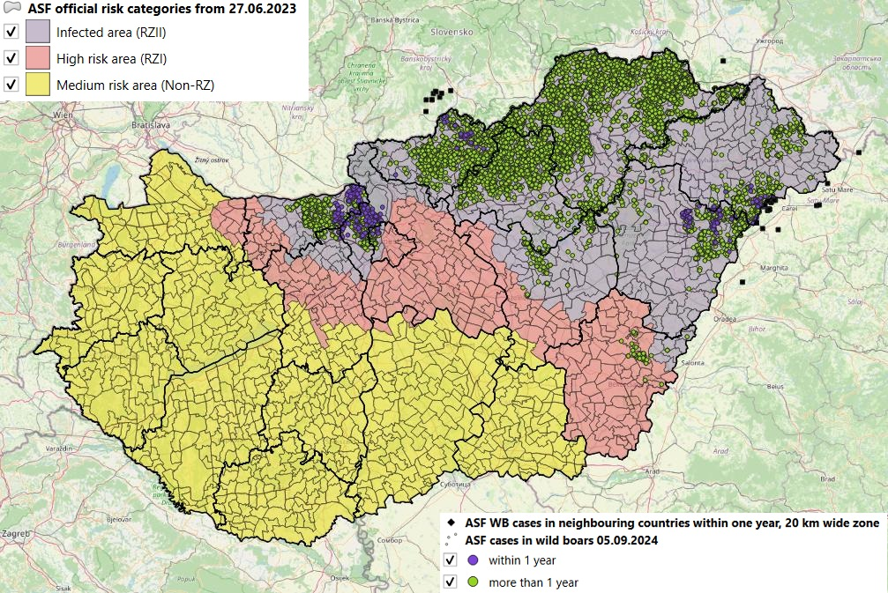
National official risk areas with Hungarian and foreign wild boar cases until 2024.09.05

Slide 30
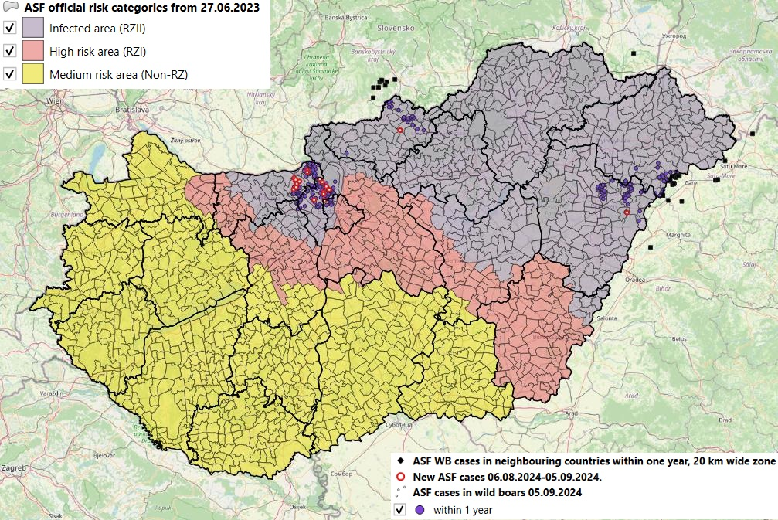
Official risk categories (status) with cases within one year highlighted for last month (as of 05.09.2024)

Slide 31
Table of all wild boar ASF cases till 05.09.2024
County | Passive surveillance |  | Active surveillance | All cases | Passive surv. %
 | Total | Dead from that
Békés | 108 | 107 | 12 | 120 | 90,00
Borsod-A-Z | 5327 | 5286 | 795 | 6122 | 87,01
Fejér | 40 | 40 | 7 | 47 | 85,11
Hajdú-Bihar | 485 | 473 | 280 | 765 | 63,40
Heves | 1909 | 1893 | 456 | 2365 | 80,72
Jász-N-K | 154 | 149 | 26 | 180 | 85,56
Komárom-E | 567 | 552 | 241 | 808 | 70,17
Nógrád | 1105 | 1104 | 390 | 1495 | 73,91
Pest | 383 | 344 | 259 | 642 | 59,66
Szabolcs-Sz-B | 533 | 525 | 199 | 732 | 72,81
HU total | 10611 | 10473 | 2665 | 13276 | 79,93

Slide 32
All ASF cases in wild boars by county till 05.09.2024.

Slide 33
ASF cases in Hungary by hunting year, until 05.09.2024
County | Passive surveillance |  | Active surveillance | All cases | Passive surv. %
 | Total | Dead from that
2018/2019. | 563 | 553 | 98 | 661 | 85,17
2019/2020. | 2748 | 2703 | 515 | 3263 | 84,22
2020/2021. | 4500 | 4464 | 1033 | 5533 | 81,33
2021/2022. | 2171 | 2156 | 349 | 2520 | 86,15
2022/2023. | 326 | 308 | 372 | 698 | 46,70
2023/2024. | 201 | 191 | 221 | 422 | 47,63
2024/2025. (till 05.09.2024.) | 102 | 98 | 77 | 179 | 56,98
Total | 10611 | 10473 | 2665 | 13276 | 79,93
Notes:
(till

Slide 34
ASF cases in wild boars in Hungary by hunting years

Slide 35
The 2022/2023. hunting year ASF cases by counties
County | Passive surveillance |  | Active surveillance | All cases | Passive surv. %
 | Total | Dead from that
Békés | 0 | 0 | 0 | 0 | --
Borsod-A-Z | 32 | 32 | 16 | 48 | 66,67
Fejér | 28 | 28 (23 KOM GMU) | 1 | 29 | 96,55
Hajdú-Bihar | 71 | 70 | 76 | 147 | 48,30
Heves | 42 | 42 | 15 | 57 | 73,68
Jász-N-K | 0 | 0 | 0 | 0 | --
Komárom-E | 9 | 8 | 35 | 44 | 20,45
Nógrád | 32 | 32 | 53 | 85 | 37,65
Pest | 78 | 62 | 118 | 196 | 39,80
Szabolcs-Sz-B | 34 | 34 | 58 | 92 | 36,96
HU total | 326 | 308 | 372 | 698 | 46,70

Slide 36
The 2023/2024. hunting year ASF cases by counties
County | Passive surveillance |  | Active surveillance | All cases | Passive surv. %
 | Total | Dead from that
Békés | 0 | 0 | 0 | 0 | --
Borsod-A-Z | 7 | 7 | 0 | 7 | 100,00
Fejér | 2 | 2 | 4 | 6 | 33,33
Hajdú-Bihar | 83 | 82 | 76 | 159 | 52,20
Heves | 5 | 5 | 1 | 6 | 83,33
Jász-N-K | 0 | 0 | 0 | 0 | --
Komárom-E | 28 (11 Pest GMU) | 23 (10 Pest GMU) | 37 (18 Pest GMU) | 65 | 43,08
Nógrád | 22 | 21 | 10 | 32 | 68,75
Pest | 31 | 28 | 65 | 96 | 32,29
Szabolcs-Sz-B | 23 | 23 | 28 | 51 | 45,10
Hungary total | 201 | 191 | 221 | 422 | 47,63

Slide 37
A 2024/2025. hunting year ASF cases by counties (till 05.09.2024.)
County | Passive surveillance |  | Active surveillance | All cases | Passive surv. %
 | Total | Dead from that
Békés | 0 | 0 | 0 | 0 | --
Borsod-A-Z | 0 | 0 | 0 | 0 | --
Fejér | 0 | 0 | 0 | 0 | --
Hajdú-Bihar | 11 | 11 | 2 | 13 | 84,62
Heves | 0 | 0 | 0 | 0 | --
Jász-N-K | 0 | 0 | 0 | 0 | --
Komárom-E | 47 | 45 (13 Pest GMU) | 43 (22 Pest GMU) | 90 | 52,22
Nógrád | 22 | 22 | 6 | 28 | 78,57
Pest | 18 | 16 | 20 | 38 | 47,37
Szabolcs-Sz-B | 4 | 4 | 6 | 10 | 40,00
Hungary total | 102 | 98 | 77 | 179 | 56,98

Slide 38
Quarterly distribution of ASF cases in hunting years in Hungary

Slide 39
Graph of ASF cases in Hungary by quarters of the hunting years

Slide 40
Lessons learned from Hungarian ASF cases on the surveillance system 1.
The highest number of cases occurred in the 2020/2021 hunting year with a total of 5533 cases, after that the number of ASF cases has steadily and significantly decreased.
In the 2021/2022 hunting year, it decreased to less than half of the cases in previous hunting year, with 2520 confirmed cases.
In the 2023/2024 hunting year there were only 422 cases, approximately 17 % of the cases in the 2021/2022 hunting year and approximately 8 % of the cases in the 2020/2021 hunting year.

Slide 41
Lessons learned from Hungarian ASF cases on the surveillance system 2.
Approximately 80% of all cases detected in wild boars (86% in the 2021/2022 hunting year) were confirmed during enhanced passive surveillance, the vast majority of these were dead ones.
Compared to previous hunting years, the passive surveillance rate decreased significantly by almost 40% to about 47% in the 2022/2023 hunting year.
The experience of all hunting years so far shows that the examination of dead wild boars has high importance, especially in the first years of the epidemic, but active surveillance is not negligible and may become more important after a few hunting years, especially with increased shooting of wild boars.
However, despite the decrease in the proportion of cases detected during passive surveillance within the total number of cases, the ASF epidemiological situation in Hungary has significantly improved now.

Slide 42
What is behind the improvement in the epidemiological situation?
The main factors behind the improvement of the epidemiological situation are:
The ASF Eradication Plan, published as an annex to Decision 2/2020 of the CVO published on 8 March 2020, amended the rules for reduction of wild boar population (diagnostic shooting for culling):
The diagnostic shooting target number is at least 150% of the number of wild boars shot during diagnostic shooting or hunting in the closed hunting year 2019/2020 as a base year in the hunting unit, for all age groups.
In January 2021, the National Action Plan for the management of wild boar population was issued and introduced, among other measures, the obligation for all hunting units to draw up a long-term plan, covering several years on the measures to be taken to achieve a maximum density of 0.5 wild boars per km² (0.5 wild boars per 100 hectares) by 28 February 2025.
In the 2024/2025 hunting year, diagnostic shooting target numbers are determined individually for each hunting unit and issued by decision in such a way as to ensure that the density target is achieved.

Slide 43
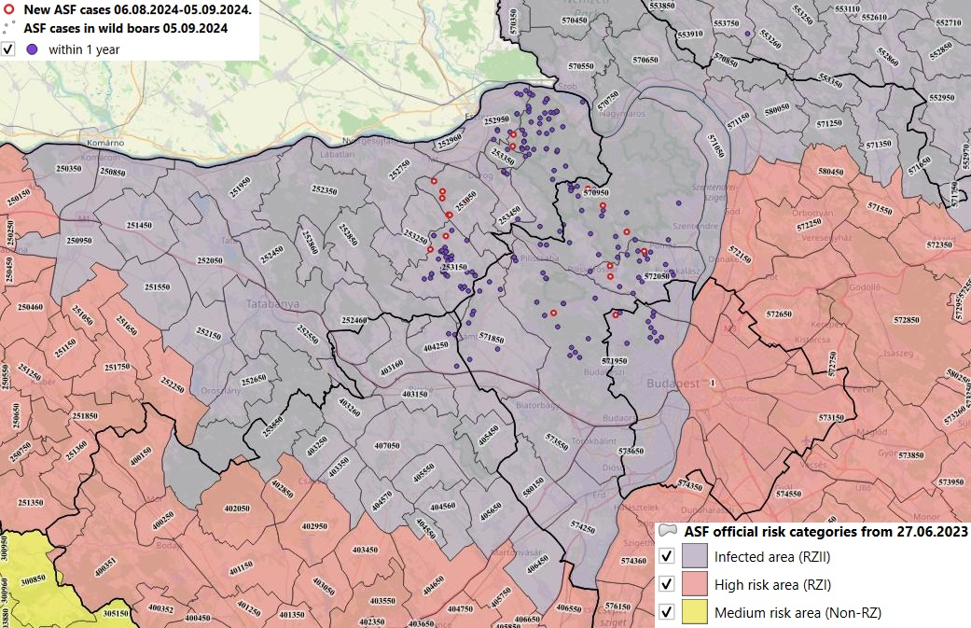
The current Hungarian epidemiological situation in parts of the country where there have been cases within one year Komárom-Esztergom, Pest and Fejér counties

Slide 44
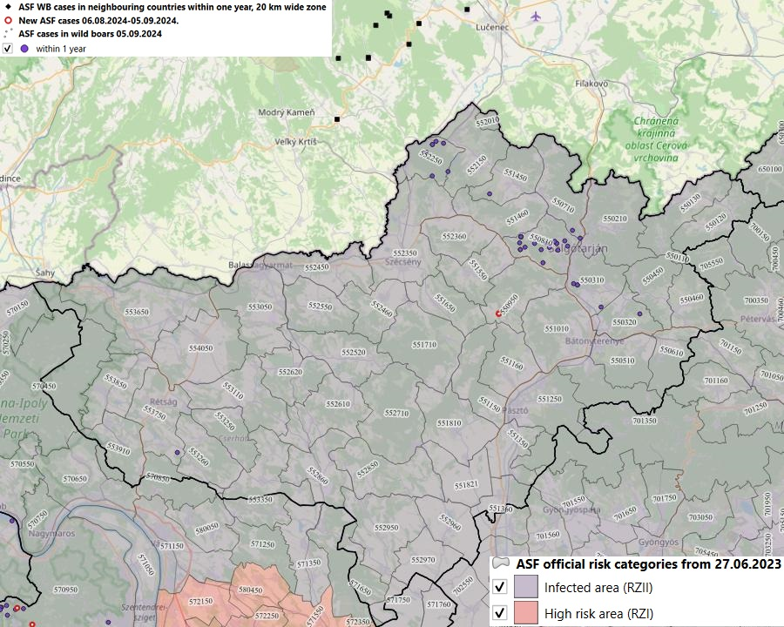
The current Hungarian epidemiological situation in parts of the country where there have been cases within one year - Nógrád county

Slide 45
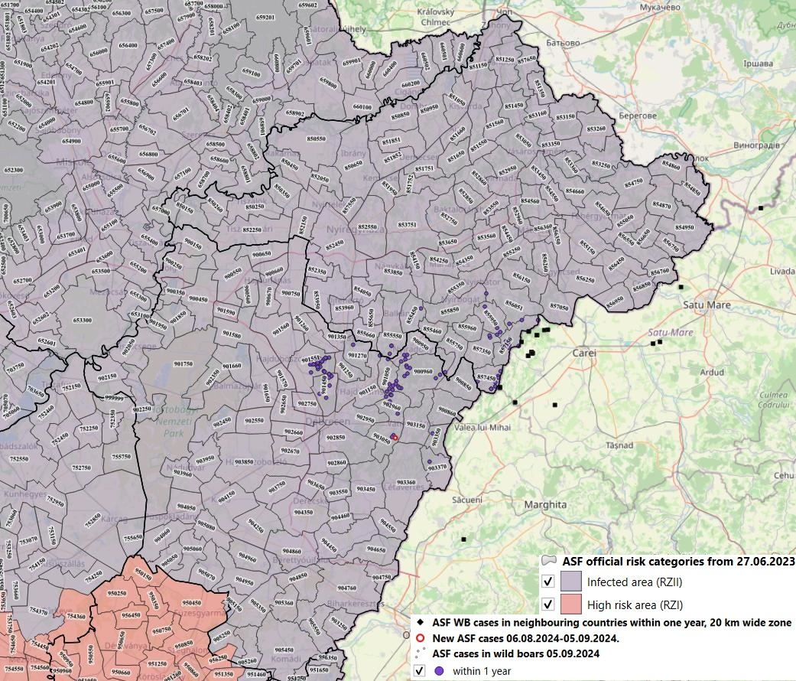
The current Hungarian epidemiological situation in parts of the country where there have been cases within one year Hajdú-Bihar and Szabolcs-Szatmár-Bereg counties

Slide 46
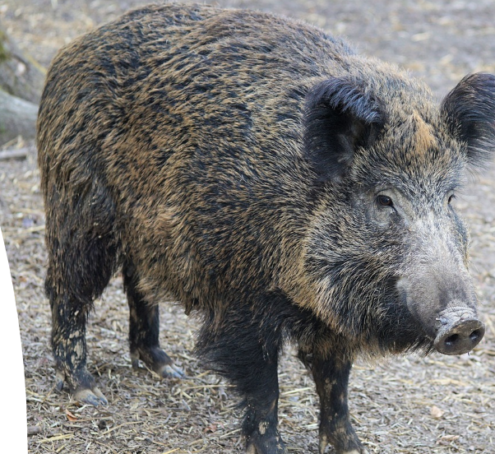
Thank you for your attention!

